Slide 1
The action potential
Foundations of Cellular Neuroscience
FAES
Spring 2016

Slide 2
Review from last week
Diffusion and electrostatic forces act on ionic gradients across biological membranes
Membrane potential is largely determined by selective permeability
When membranes are permeable to multiple ions, the membrane potential is determined by the relative balance of membrane conductances

Slide 3
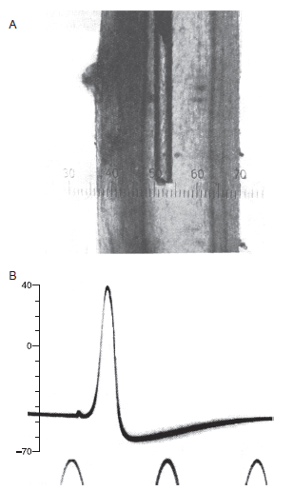
The action potential recorded in squid giant axon
AP overshoot or peak
Resting potential
AP undershoot or trough
Figure 12.1

Slide 4
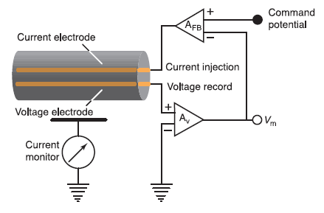
The voltage clamp technique
Two independent electrodes are inserted into the axon. The voltage electrode records the membrane voltage and the current electrode injects current.
A feedback circuit compares the recorded membrane potential with the command potential and injects current into the axon if the two potentials differ.
This results in “clamping” of V_{m} to the command potential. The current necessary to maintain the command V will be equal and opposite to the ionic current through the axon membrane.
Allowed separation of voltage-dependence and time-dependence of g_{Na} and g_{K}.
Figure 12.5

Slide 5
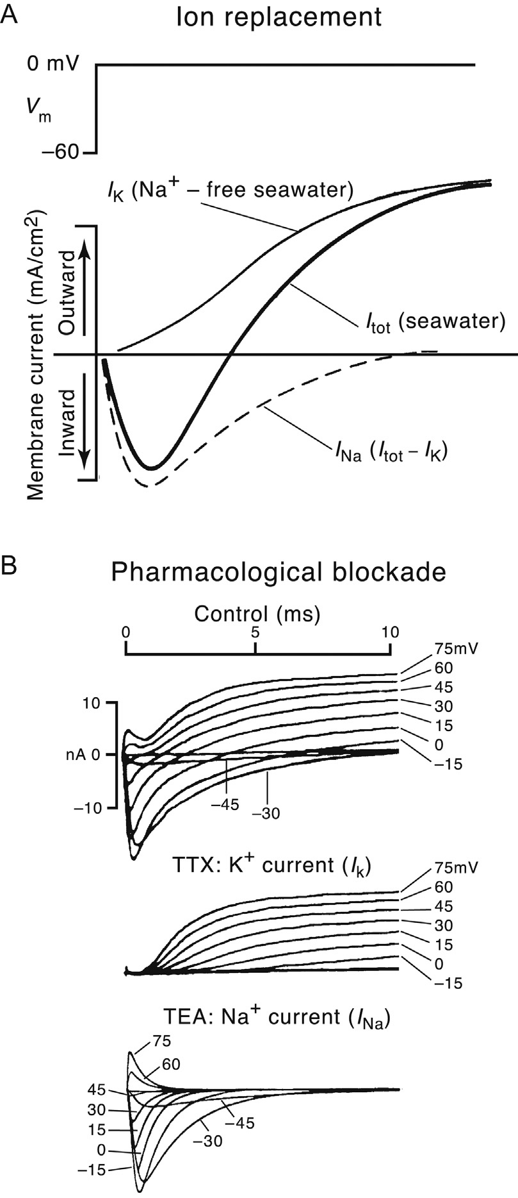
Voltage-clamp reveals ionic currents
Figure 12.6

Slide 6
What are the major differences in I_{K} and I_{Na}?
Are there differences in:
The shape of the currents?
The direction of the currents?
The size of the currents at different voltages?
Figure 12.6

Slide 7
What are the major differences in I_{K} and I_{Na}?
The Na⁺ current activates rapidly in a voltage-dependent manner.
The current then inactivates meaning the Na⁺ conductance decreases even though the membrane remains depolarized. Inactivation is greater at depolarized voltages. Some fraction of Na⁺ channels are inactivated at rest.
The K⁺ current activates slowly in a voltage-dependent manner. The current remains active for the duration of the voltage step. The K⁺ current turns off or deactivates at the termination of a voltage step. Deactivation is also time-dependent.
This type of current is referred to as a “delayed rectifier” K⁺ current.
Figure 12.6

Slide 8
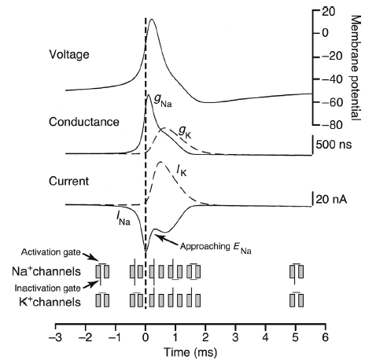
Na⁺ and K⁺ currents during an AP
What parts of an action potential can be understood using the “weighted average” voltage equation?
At rest g_{K} > g_{Na} so V_{m} is near E_{K}
At peak of AP, g_{Na} > g_{K} so V_{m} approaches E_{Na}
At trough of AP, g_{K} is larger than g_{K} at rest, so V_{m} is more negative, closer to E_{K}
Figure 12.7

Slide 9
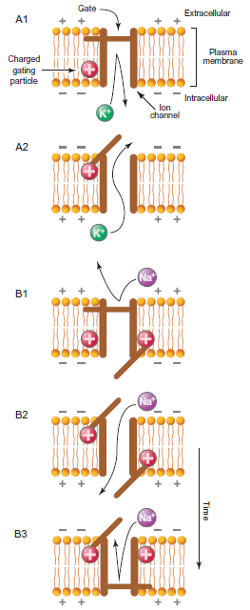
Scheme of the gate model
K⁺ channel
Na⁺ channel
Figure 14.6

Slide 10
MetaNeuron demo of threshold
When the membrane is depolarized from rest to a membrane potential below threshold, I_{K} > I_{Na} and the outward currents will return the membrane potential to V_{rest}.
Threshold represents a tipping point at which the depolarization of the membrane activates enough Na⁺ channels to overcome the outward I_{K}. This leads to further depolarization of the membrane, which causes greater activation of Na⁺ channels, which leads to further depolarization…
… causing greater activation of Na⁺ channels pushing the membrane towards E_{Na}. This process is a positive feedback loop and leads to the explosive rising phase of the action potential.

Slide 11
MetaNeuron demo of refractory periods
The absolute refractory period refers the time period immediately after an action potential when another action potential cannot be generated.
This is due to the inactivation of Na⁺ channels.
The relative refractory period follows the absolute refractory period and corresponds to the AP afterhyperpolarization. During the relative refractory period, an AP may be evoked; however, greater current injection will be required.
The membrane potential is farther from threshold compared to V_{rest}. Furthermore, the lingering activity of the delayed-rectifier K⁺ channels will oppose depolarization of the membrane.

Slide 12
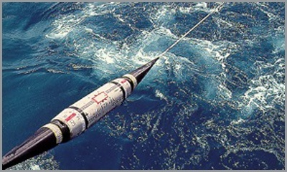
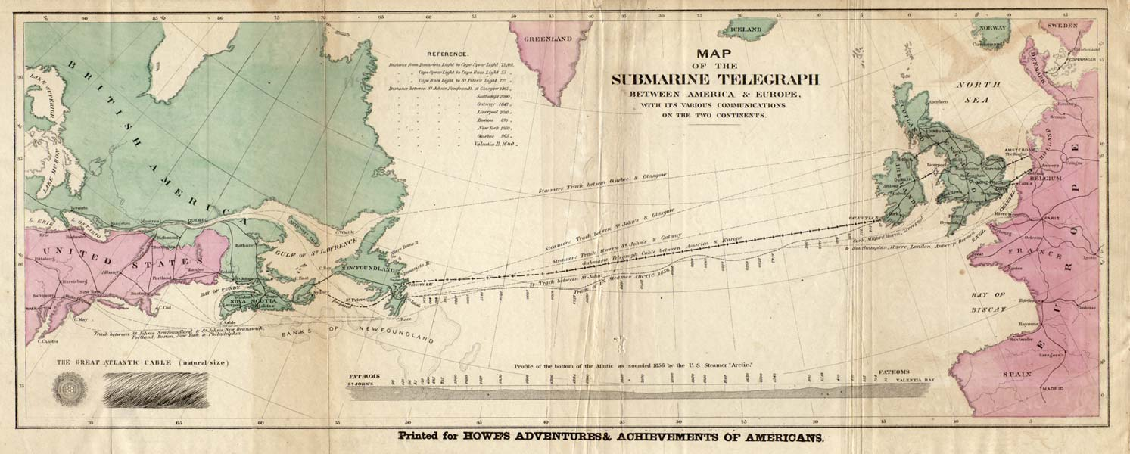
Propagation of electrical signals
Repeaters laid every 40-60 km
~60-100 repeaters from Newfoundland to England (3800 km)
https://www.quora.com/How-are-major-undersea-cables-laid-in-the-ocean

Slide 13
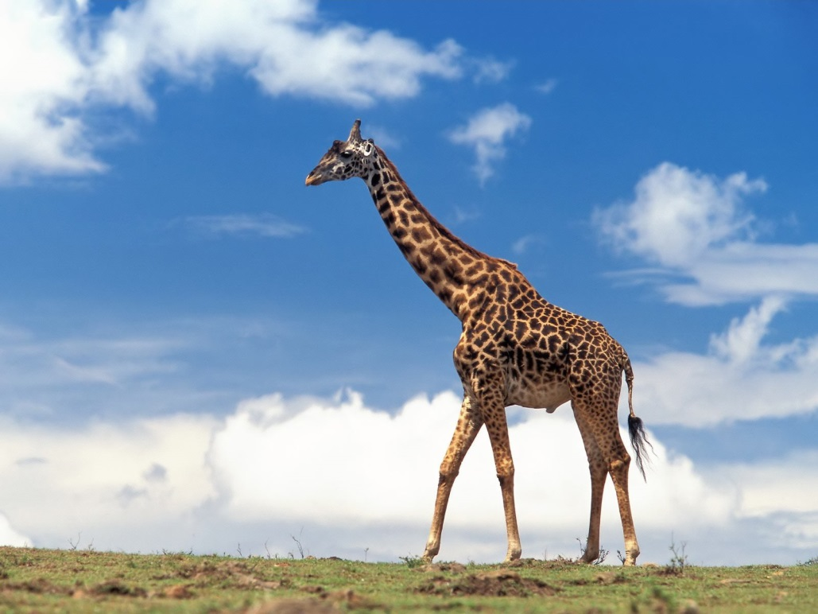
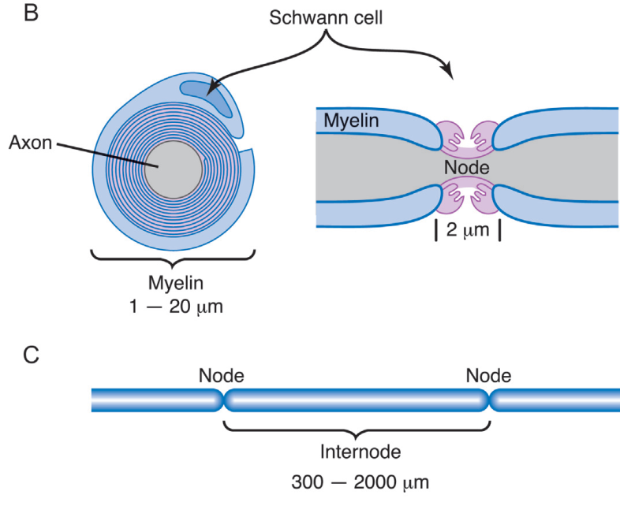
Propagation of electrical signals
animalspot.net
Nodes of Ranvier every 300-2000 µm
~2750-18000 repeaters from brain to paw (~5.5 m)

Slide 14
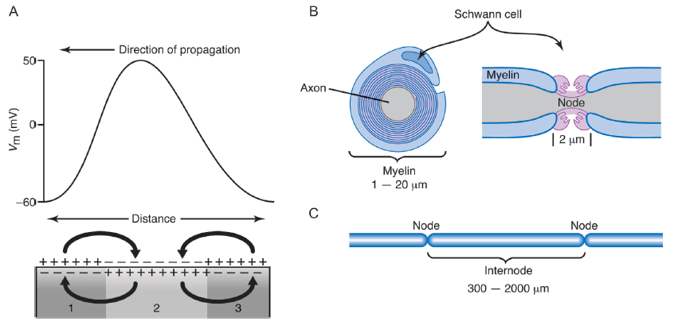
Axonal propagation involves both passive and active processes

Slide 15
Axonal propagation involves both passive and active processes
Myelin acts to increase the resistance of the axon.
But also decreases the capacitance (by increasing the distance between the axoplasm and the extracellular solution).
Gaps between myelin are called nodes of Ranvier and contain a high density of Na⁺ channels where action potentials are actively regenerated.

Slide 16
Action potential key points
Action potentials are generated by the rapid influx of Na⁺ ions followed by efflux of K⁺ ions.
Action potentials have thresholds which lead to all-or-none generation.
H&H voltage-clamp analysis of squid giant axon allowed separation and characterization of underlying currents.
AP propagation is a result of both passive and active propagation.
Long distance propagation is supported by myelination of axons.

Slide 17
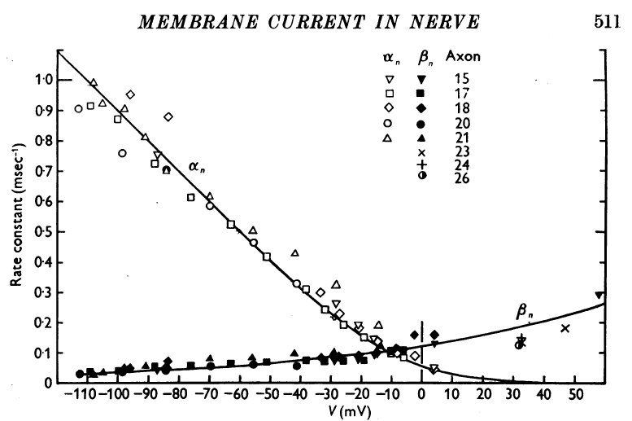
An important note on discussion articles for weeks 2 and 3
Hodgkin & Katz and Hodgkin & Huxley use opposite sign conventions
Chapter 14 and review articles provide a helpful framework of the articles
voltages increasingly depolarized from rest

